Slide 1
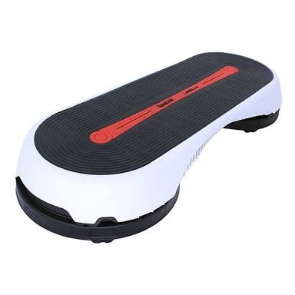
SMART STEP

Slide 2
Contents
Abstract
Introduction
Smart Step Hardware
Smart Step Firmware
Low Power Schemes
Android Implementation
Conclusion

Slide 3
ABSTRACT
Shoe-mounted wearable sensors can be used in applications, such as activity monitoring, gait analysis, post - stroke rehabilitation, body weight measurements and energy expenditure studies.
The Smart step is an always-on electronic device that comprises a 3D accelerometer, a 3D gyroscope and resistive pressure sensors implemented around a CC2540 system-on-chip with an 8051 processor core,Bluetooth low energy(BLE) connectivity and flarsh memory buffer.
The Smart Stephen is wireless interfaced to an Android smart phone application with data logging and visualisation capabilities.
The results of the mechanical reliability test on the Smart Step indicate that the pressure sensors in the Smart Step tolerated prolonged human wear.
The Smart Step system collected more than 98.5% of the sensor data, in real usage scenarios, having intermittent connectivity with the smartphone.

Slide 4
INTRODUCTION
Shoe-based activity and/or gait monitoring systems are gaining widespread popularity in research, as well as in commercial market place.
One of the most popular applications for shoe-based sensors is gait analysis, and various analysis systems based on different sensor modalities have been proposed and applied both to healthy individuals and patients with neurological disorders.
Smartshoe had demonstrated the accurate(98%) classification of the six major postures and activities in healthy individuals and the comparable recognition of postures and activities in post-stroke individuals.
SamrtShoe was also used for the estimation of the body weights of wearers and to accurately capure the temporal gait parameters of healthy and post-stroke individuals.

Slide 5
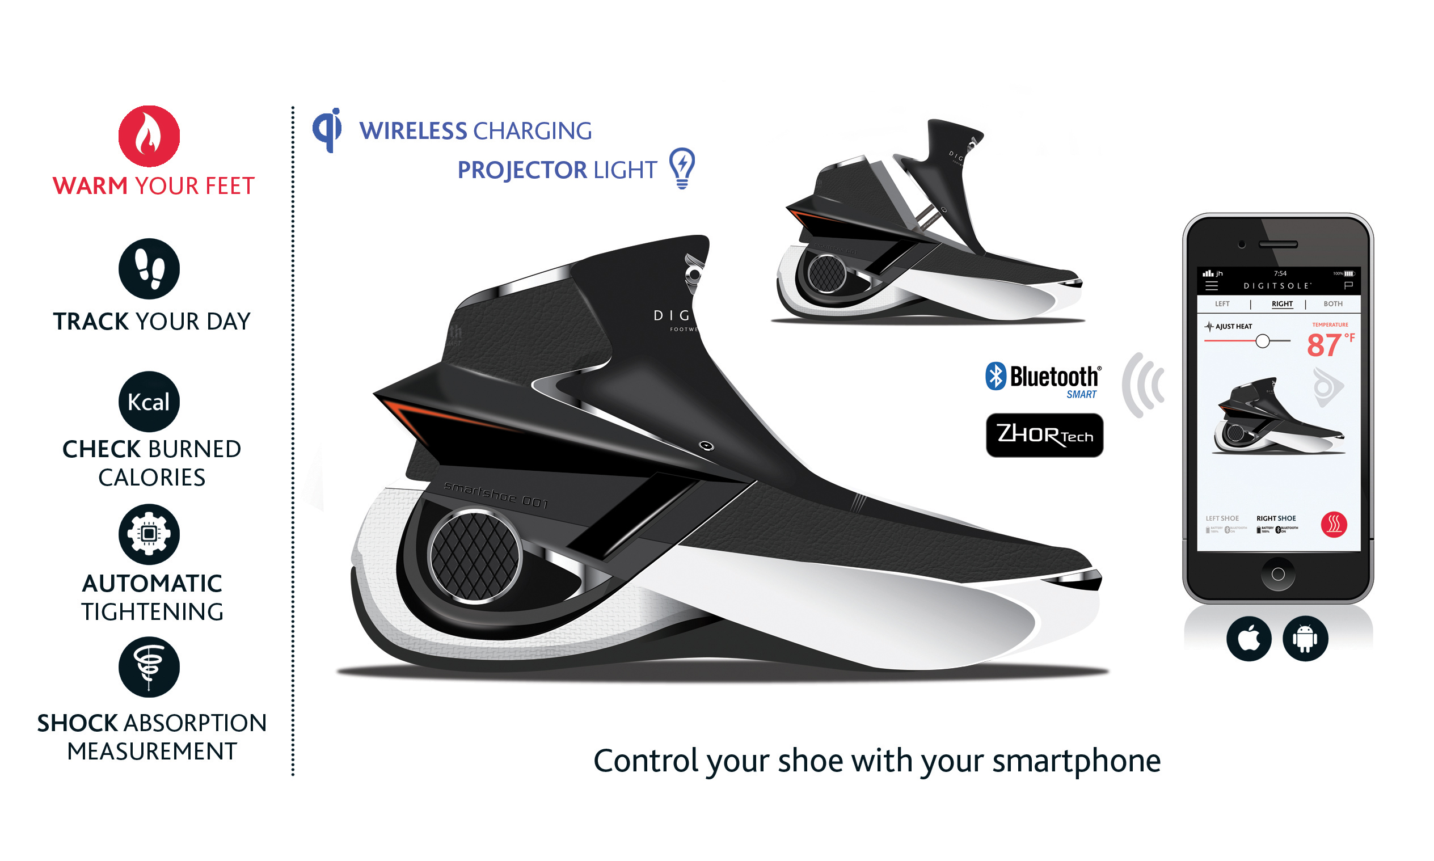

Slide 6
SMART STEP HARDWARE
The 0.8mm thick, 4 layer PCB is 24mm×19mm in size. The fully assembled board together with the battery weighs 4g. The embedded system hardware is comprised of BR-LE4. 0-S2A Bluetooth Low Energy(BTLE) module, a 3D accelerometer (ADXL 346), power management circuitry, pressure sensor interface,AT25DF641 flash and ML2020 45mAh rechargeable Lithium battery.
Smart step is based on Blueradios BR-LE4.0-S2A BTLE module, which utilizes Texts Instruments CC2540 System-On-Chip, and has a footprint of 11.8mm×17.6mm.
In BTLE, the data transmission happens in 'connection events' lasting for ~2.8ms or longer with the peak current consumption on the order of 30mA.

Slide 7
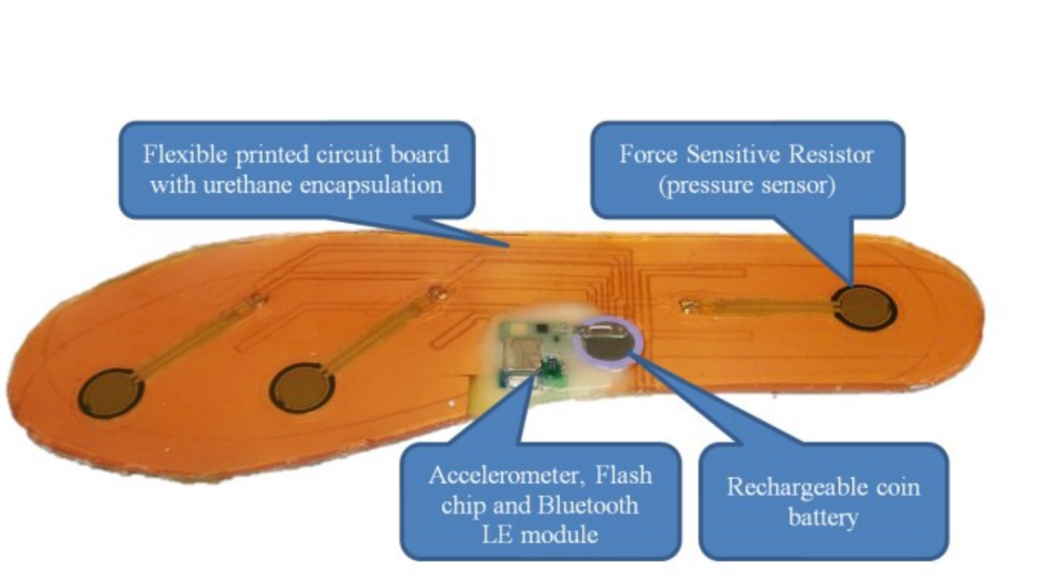

Slide 8
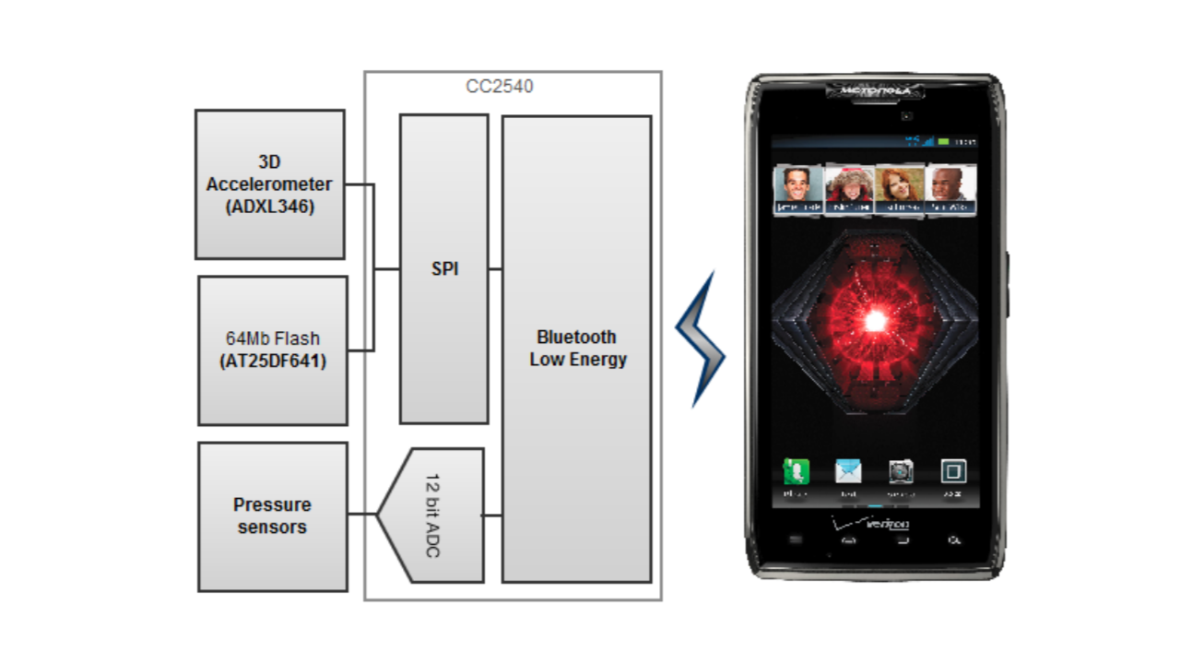

Slide 9
SMART STEP FIRMWARE
The firmware for the smartstep is built around TI's BLE stack version 1.4.0.
The algorithm for the application from the SmartStep point of view is completely reentrant.
It is an "always on" system, which has no reset or power switch-on-board.

Slide 10
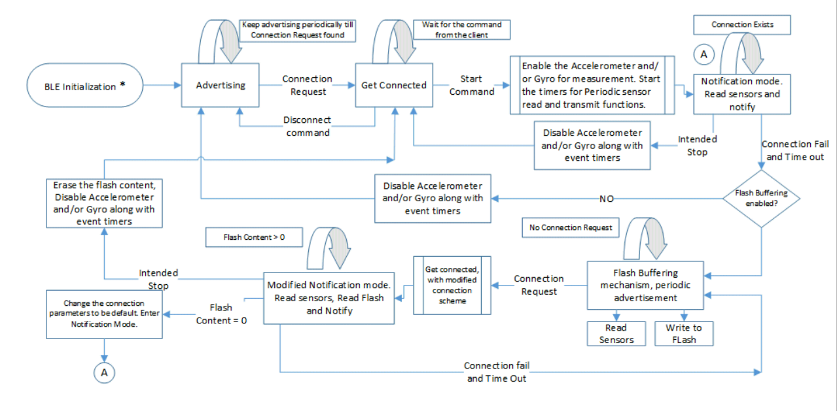

Slide 11
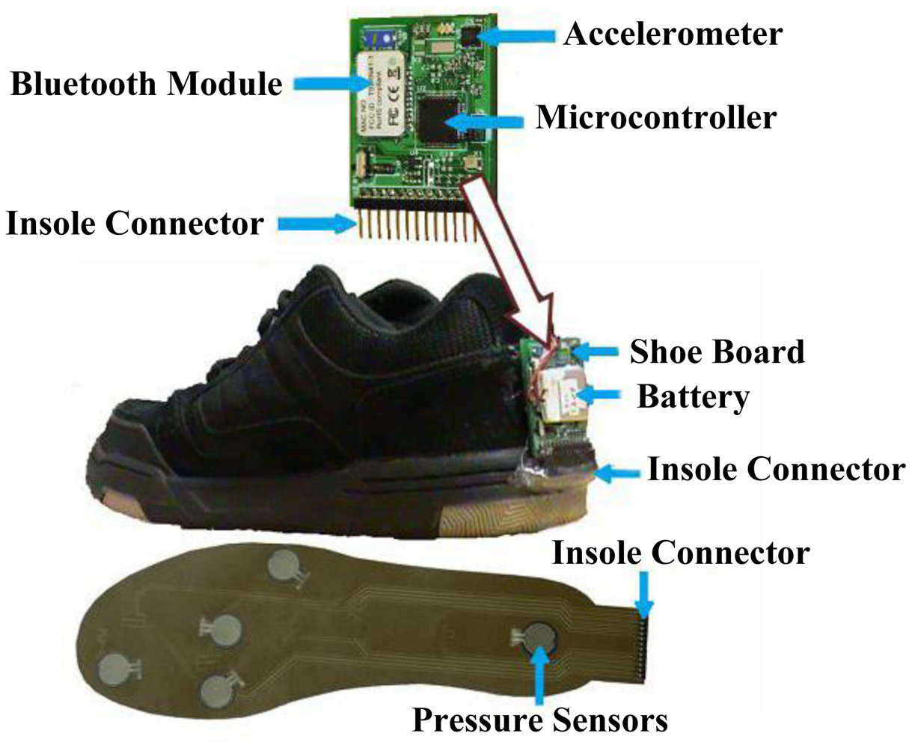

Slide 12
LOW POWER SCHEMES
During advertising, the smart step remains in limited discoverable mode.
For the sensor data transmission from the server to the client, notification methodology is used as opposed to indication methodology.
While in measurement mode, the ADXL346 operates in low power, with the output data rate set to 25Hz. This low-power mode is slightly noisier than the normal operating mode of ADXL346, but consumes 50% less current than in the normal mode.

Slide 13
ANDROID IMPLEMENTATION
The current implementation of android application (APP) is based on Google's most recent Android version 4.4.2, which has native android support for BLE.
The application checks radio signal strength indicator (RSSI) during scanning and automatic reconnection takes place

Slide 14
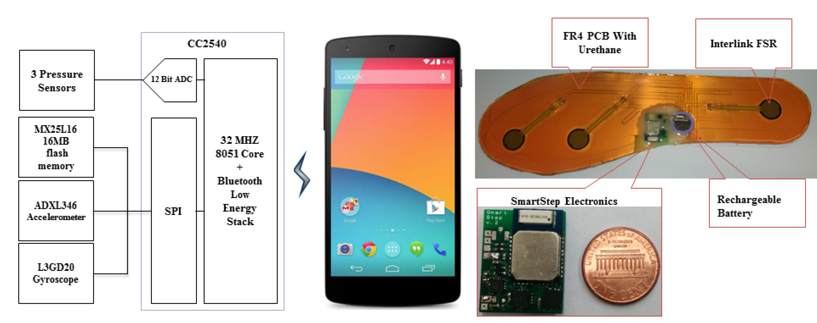

Slide 15
CONCLUSION
The results from mechanical reliability experiment suggested that the smartstep pressure sensors tolerated prolonged human wear.
These, results along with the proposed improvements, suggest that the SmartStep can be used in the long-term monitoring of gait, physical activity or other parameters.
Utilizing the smartstep monitoring systems in studies on the physical activity and gait monitoring of human subjects, in free living conditions, and processing the sensor data captured from Smartstep will be topics of our future research.

Slide 16
THANK YOU

